Slide 1

Classification of Myocardial Infarction
Team :
Mr. Akshay Sanjiv Kamble
Ms. Sakshi Sanjay Bais
Mr. Prashant Punamchand Jadhav
Ms. Tanavi Sandip Daware
Mr. Rohit Ashok Patil
Ms. Sakshi Vijay Wagh
Ms. Nikhitha K R
Mentors :
Mr. Rajshekar and Pallavi Bapuram
Date : 26th April 2023

Slide 2
Business Problem:
To classify the patients from their records.
Objective:
Myocardial Infarction(Commonly known as “Heart attack”) is one of the most challenging problems of modern medicine. Acute myocardial infarction is associated with high mortality in the first year after it. The incidence of MI remains high in all countries. This is especially true for the urban population of highly developed countries, which are exposed to chronic stress factors, irregular and not always balanced nutrition.
The Given dataset consists of 124 variables with 1700 records of patients. Classify the Lethal outcome (cause) (LET_IS)(Y variable) by using the given dataset.

Slide 3
Data set details :
Dataset has 124 columns and 1700 rows indicating patient information . As ID column is just for reference we have 123 columns.
We have two types of data for column which are nominal and ordinal , which are represented by numerical values indicating different categories.
Null values and their handling : We have 65 columns which have 0 to 3% null values, 54 columns have 3 to 50% null values while 4 columns null values greater than 50%. For columns having null value greater than 30% we decided to drop those columns. As for columns having null values less than 30%, we used df.fillna( ) method to fill those values with median of that column.
Dataset has 0 duplicated values.

Slide 4
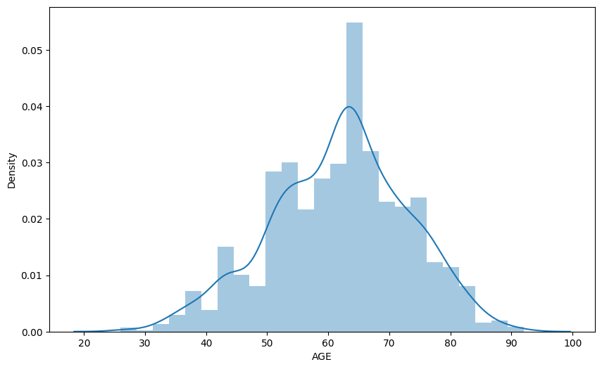
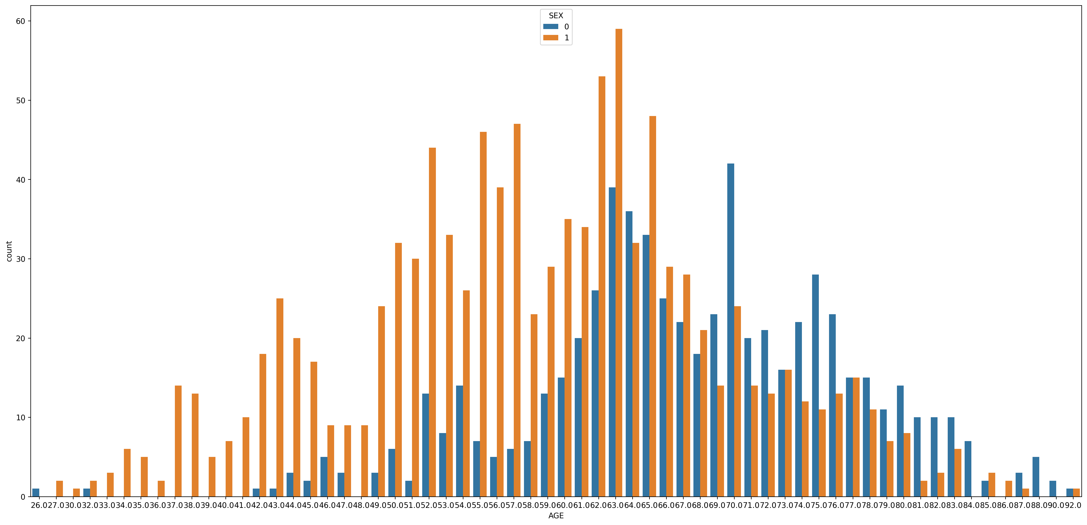
EDA :

Slide 5
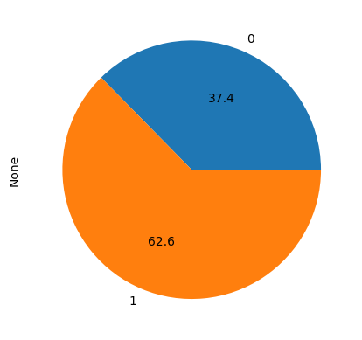
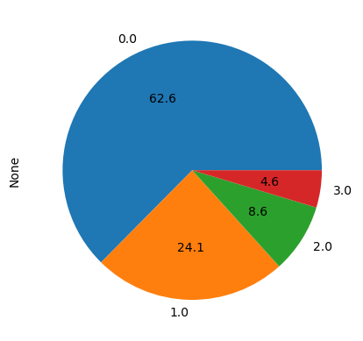
Age-wise 37.4% record are female and 62.6% records are for males. Most of male records are between age of 49 to 70 while, female record are between age of 60 to 80 .
Pie graph representation of Age and INF_ANAM :

Slide 6
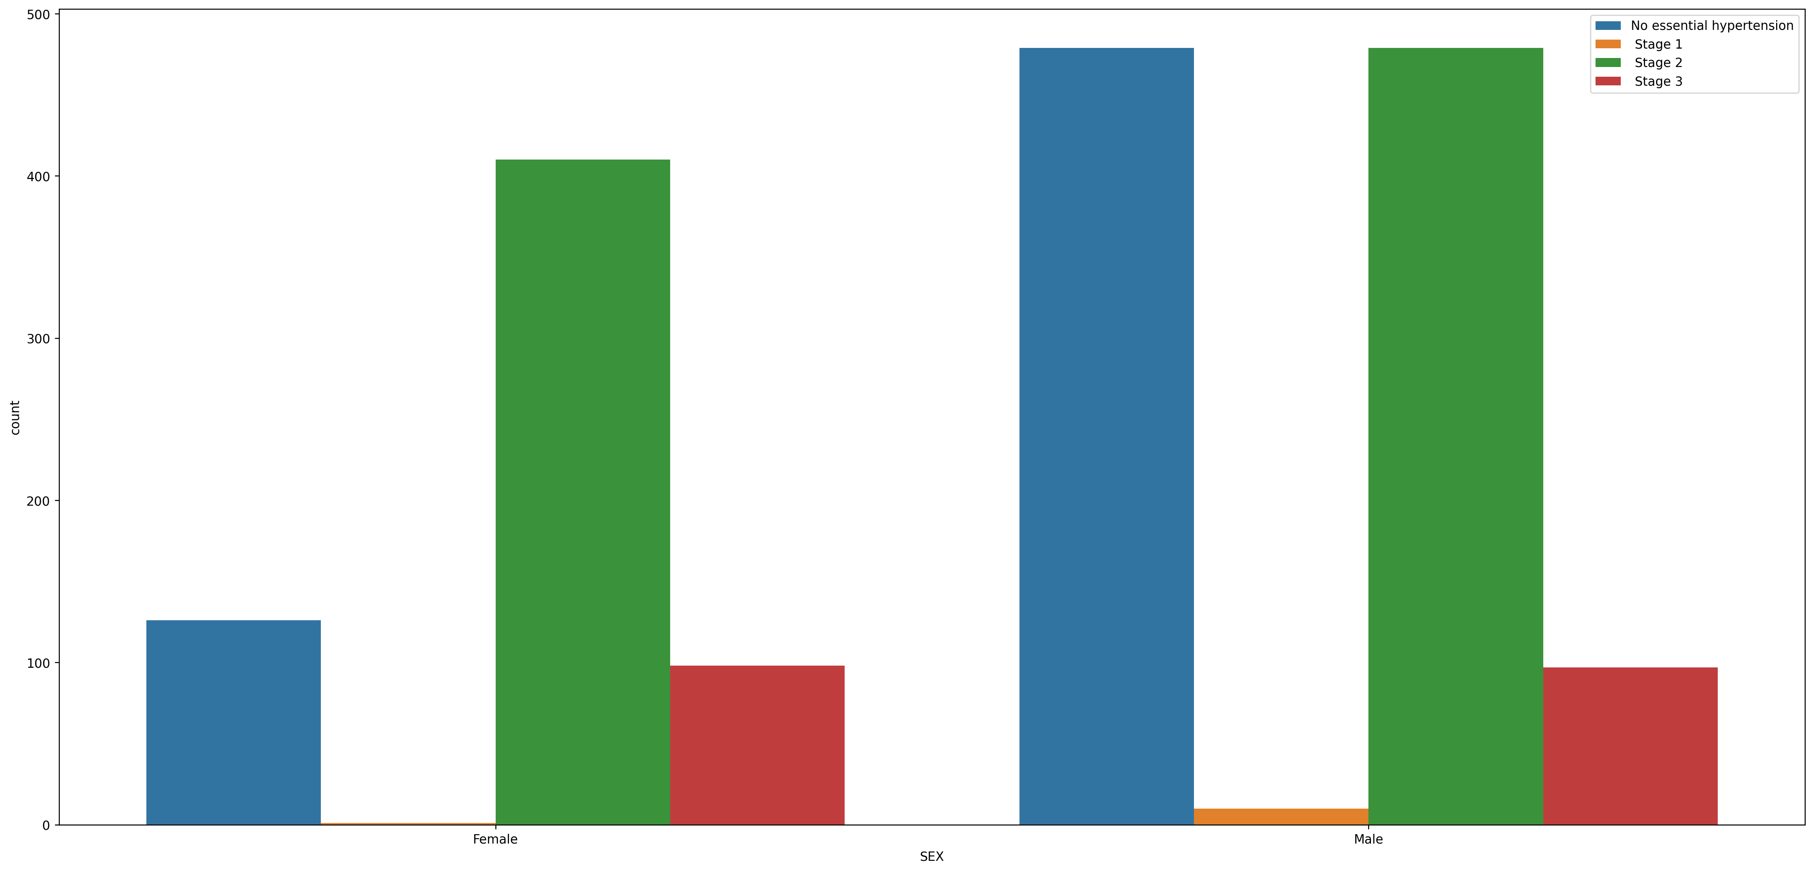
Sex-wise distribution of GB column :

Slide 7
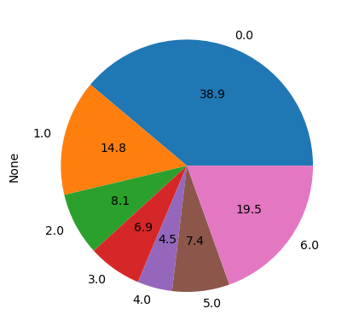
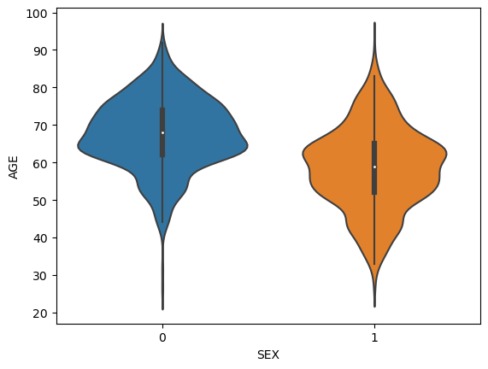
Pie graph of STENOK_AN column :
Age-wise representation of Sex column :

Slide 8
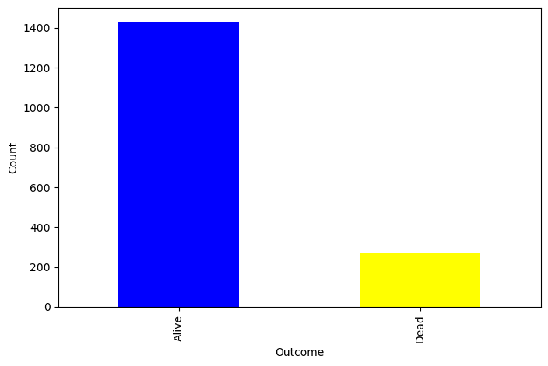
Outcome column countplot representation :
We created new column named ‘outcome’, which contain two values Alive (0) and Dead(1) respectively. It is created by using ‘LET_IS’ column where values with value 0 were represented as Alive while every other value were represented as Dead.

Slide 9
Model Building

Slide 10
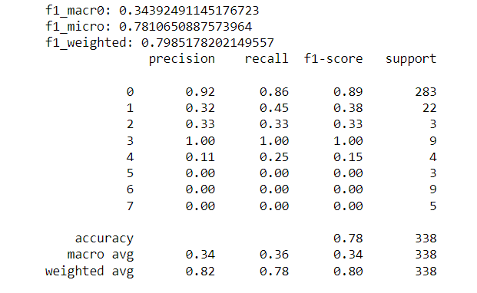
Decision Tree model :
The accuracy of the Decision tree model is 78%. The micro f1 score is 0.78 and weighted f1 score is 0.79 which is good.

Slide 11
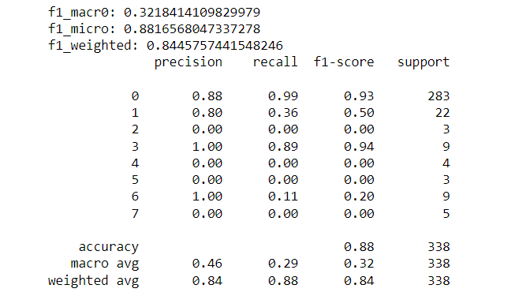
Random Forest model :
The accuracy of the Random Forest model is 88%. The micro f1 score is 0.88 and weighted f1 score is 0.84 which is good.

Slide 12
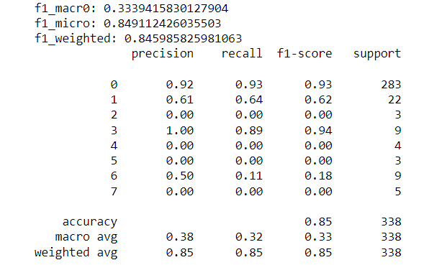
Logistic Regression model :
The accuracy of the Logistic Regression model is 85%. The micro f1 score is 0.84 and weighted f1 score is 0.84 which is good.

Slide 13
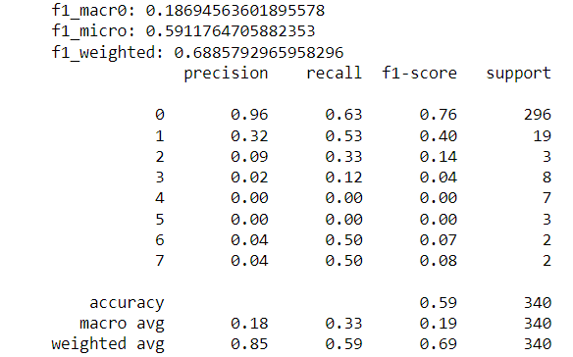
K-nearest neighbour model :
The accuracy of the K-nearest neighbour model is 59%. The micro f1 score is 0.59 and weighted f1 score is 0.68.

Slide 14
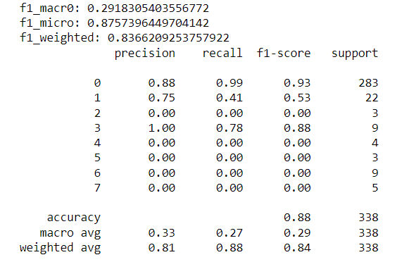
SVM model :
The accuracy of the Support Vector Machine model is 88%. The micro f1 score is 0.87 and weighted f1 score is 0.83 which is good.

Slide 15
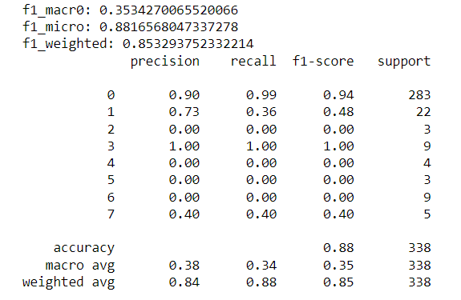
XGBoost model :
The accuracy of the XGBoost model is 88%. The micro f1 score is 0.88 and weighted f1 score is 0.85 which is good.

Slide 16
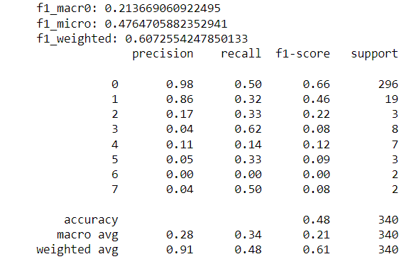
Naïve Bayes model :
The accuracy of the Naïve Bayes model is 48%. The micro f1 score is 0.47 and weighted f1 score is 0.60 which is good.

Slide 17
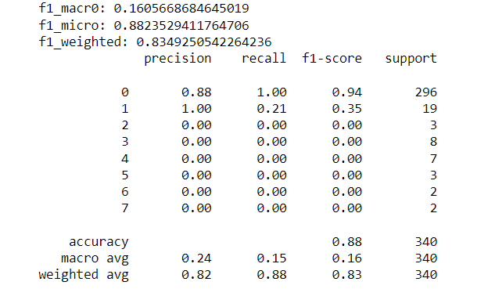
Naïve Bayes (Gaussian) model :
The accuracy of the Naïve Bayes model is 88%. The micro f1 score is 0.88 and weighted f1 score is 0.83 which is good.

Slide 18
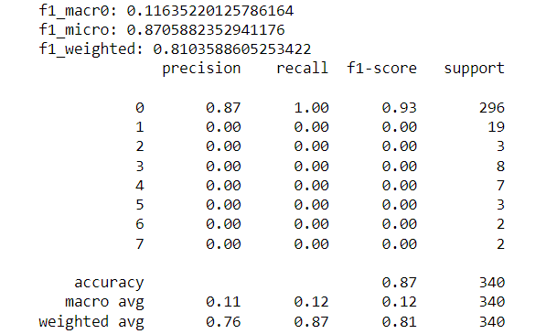
ANN model :
The accuracy of the ANN model is 87%. The micro f1 score is 0.87 and weighted f1 score is 0.81 which is good.

Slide 19
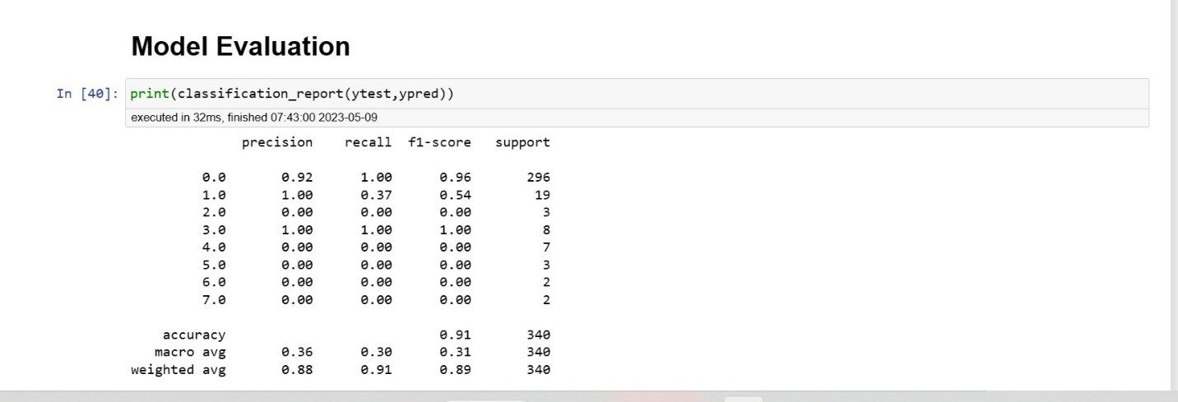
Histogram Gradient Boosting:
The accuracy of the H gradient Boosting Classifier() is 91%. By reducing the number of features, it will be used to increase the algorithm’s speed. As a result, the same notion is employed in DT by grouping with histograms, which is known as the HGB classifier.

Slide 20
Model Accuracy & f1 Score :
Model Name | Accuracy | f1 Score
Decision Tree | 78% | 0.79
Random Forest | 88% | 0.84
Logistic Regression | 85% | 0.84
KNN | 59% | 0.68
SVM | 88% | 0.83
XGBoost | 88% | 0.85
Naïve Bayes | 48% | 0.60
Naïve Bayes (Gaussian) | 88% | 0.83
ANN | 87% | 0.87
HgradientBoosting | 91% | 0.91

Slide 21
Model Accuracy by Lasso Regularization :
Model Name | Accuracy | Training Acc. | Testing Acc.
Decision Tree | 0.86 | 0.93 | 0.86
Random Forest | 0.99 | 1.0 | 0.99
Logistic Regression | 0.89 | 0.88 | 0.88
KNN | 0.96 | 0.96 | 0.95
SVM | 0.99 | 0.99 | 0.98
XGBoost | 0.99 | 1.0 | 0.98
Naïve Bayes | 0.64 | 0.67 | 0.67
Naïve Bayes (Gaussian) | 0.13 | 0.12 | 0.13
ANN | 0.13 | 0.12 | 0.11
HgradientBoosting | 0.99 | 1.0 | 0.99

Slide 22
Thank you

